Slide 1
CS 380
Introduction to Database Systems
Chapter 6: The Relational Algebra and Relational Calculus

Slide 2
Outline
Introduction
Relational Algebra
  Unary Relational Operations
  Relational Algebra Operations from Set Theory
  Binary Relational Operations
  Additional relational Operations
  Examples of Queries in Relational Algebra
Relational Calculus
  Introduction to Tuple Relational Calculus
  Introduction to Domain Relational Calculus
Chapter 7: The Relational Algebra and Relational Calculus
1

Slide 3
Introduction
A data model must include a set of operations to manipulate
relations and produce new relations as answers to queries.
Formal languages for the relational model:
  Relational algebra: specifies a sequence of operations to specify
  a query.
  Relational calculus: specifies the result of a query.
  (without specifying how to produce the query result)
    Tuple calculus.
    Domain Calculus.
Chapter 7: The Relational Algebra and Relational Calculus
2

Slide 4
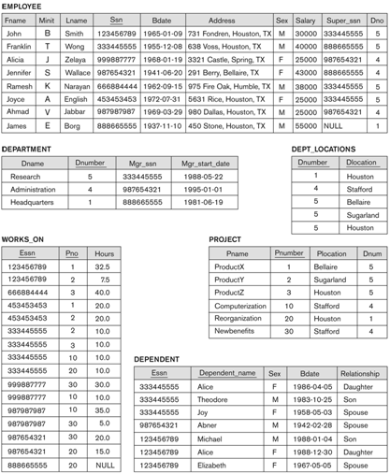
Example
Chapter 7: The Relational Algebra and Relational Calculus
3

Slide 5
Relational Algebra
The basic set of operations for the relational model is known as the
relational algebra.
These operations enable a user to specify basic retrieval requests.
The result of a retrieval is a new relation, which may have been
formed from one or more relations.
A sequence of relational algebra operations forms a relational
algebra expression.
Chapter 7: The Relational Algebra and Relational Calculus
4

Slide 6
Relational Algebra
Two basic sets of operations:
  Relational operators (specific for relational databases):
    Select.
    Project.
    Join.
    Division.
  Set Theoretic Operators:
    Union.
    Intersection.
    Minus.
    Cartesian product.
Chapter 7: The Relational Algebra and Relational Calculus
5

Slide 7
Basic Relational Algebra Operations
Select
Project
Union
Intersection
Difference
R
R
R
S
S
S
Cartesian Product
*
Chapter 7: The Relational Algebra and Relational Calculus
6

Slide 8
Unary Relational Operations - SELECT
Selects a subset of the tuples from a relation that satisfy a selection
condition.
Syntax:
σ _{<selection condition>} (<relation name>)
Examples:
  Select the EMPLOYEE tuples whose department is 4.
σ _{Dno=4} (EMPLOYEE)
  Select the tuples for all employees who either work in
  department 4 and make over $25,000 per year, or work in
  department 5 and make over $30,000.
σ (Dno=4 AND Salary>25000) OR (Dno=5 AND Salary>30000) (EMPLOYEE)
Chapter 7: The Relational Algebra and Relational Calculus
7

Slide 9
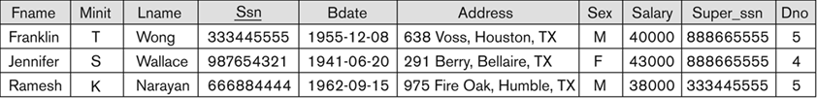
Unary Relational Operations - SELECT
σ (Dno=4 AND Salary>25000) OR (Dno=5 AND Salary>30000) (EMPLOYEE)
Chapter 7: The Relational Algebra and Relational Calculus
8

Slide 10
Unary Relational Operations - SELECT
The SELECT operation σ _{<selection condition>} (R) produces a relation S
that has the same schema as R
The select operation is commutative:
σ _{<condition1>} (σ _{<condition2>} (R)) = σ _{<condition2>} (σ _{<condition1>} (R))
A cascaded SELECT operation may be replaced by a single
selection with a conjunction of all the conditions:
σ _{<condition1>} (σ _{<condition2>} (σ _{<condition3>} (R)))
= σ <condition1> AND <condition2> AND <condition3> (R)
Chapter 7: The Relational Algebra and Relational Calculus
9

Slide 11
Unary Relational Operations - PROJECT
Selects certain columns from the table and discards the other
columns.
Syntax:
π _{<attribute list>} (<relation name>)
Example: list each employee’s first and last name and salary.
π _{Lname, Fname, Salary} (EMPLOYEE)
The project operation removes any duplicate tuples, so the result of
the project operation is a set of tuples and hence a valid relation.
Chapter 7: The Relational Algebra and Relational Calculus
10

Slide 12
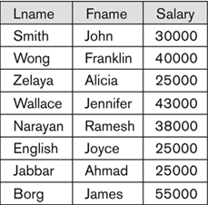
Unary Relational Operations - PROJECT
π _{Lname, Fname, Salary} (EMPLOYEE)
Chapter 7: The Relational Algebra and Relational Calculus
11

Slide 13
Sequence of Operations & RENAME Operation
We can:
  Nest the relational algebra operations as a single expression, or
  Apply one operation at a time and create intermediate result
  relations, and give it a name.
Example: retrieve the first name, last name, and salary of all
employees who work in department number 5.
π _{Fname, Lname, Salary} (σ _{Dno=5} (EMPLOYEE))
or
TEMP σ _{Dno=5} (EMPLOYEE)
R π _{Fname, Lname, Salary} (TEMP)
The rename operator is ρ.
Chapter 7: The Relational Algebra and Relational Calculus
12

Slide 14
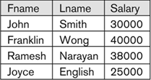
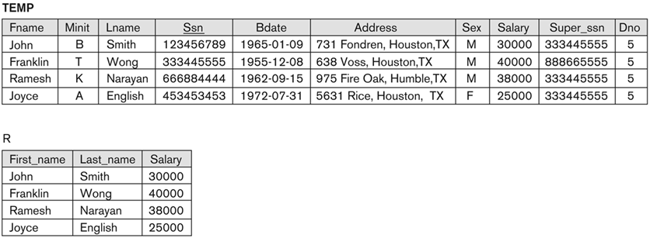
Sequence of Operations & RENAME Operation
π _{Fname, Lname, Salary} (σ _{Dno=5} (EMPLOYEE))
TEMP σ _{Dno=5} (EMPLOYEE)
R(First_name,Last_name,Salary) π _{Fname, Lname, Salary} (TEMP)
Chapter 7: The Relational Algebra and Relational Calculus
13

Slide 15
Relational Algebra Operations From Set Theory
UNION, INTERSECTION, & MINUS
Operands need to be union compatible for the result to be a valid
relation.
In practice, it is rare that two relations are union compatible
(occurs most often in derived relations).
Chapter 7: The Relational Algebra and Relational Calculus
14

Slide 16
Relational Algebra Operations From Set Theory - UNION
The result of this operation, denoted by R ∪ S, is a relation that
includes all tuples that are either in R or in S or in both R and S.
Duplicate tuples are eliminated.
Chapter 7: The Relational Algebra and Relational Calculus
15

Slide 17
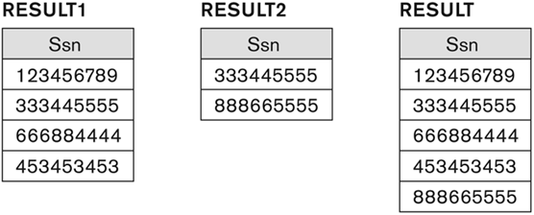
Relational Algebra Operations From Set Theory - UNION
Example: retrieve the SSN of all employees who either work in
department 5 or directly supervise an employee who works in
department 5.
DEP5_EMPS σ _{Dno=5} (EMPLOYEE)
RESULT1 π _{Ssn} (DEP5_EMPS)
RESULT2(Ssn) π _{Super_ssn} (DEP5_EMPS)
RESULT RESULT1 ∪ RESULT2
Chapter 7: The Relational Algebra and Relational Calculus
16

Slide 18
Relational Algebra Operations From Set Theory - INTERSECTION
The result of this operation, denoted by R S, is a relation that
includes all tuples that are in both R and S.
∪
Chapter 7: The Relational Algebra and Relational Calculus
17

Slide 19
Relational Algebra Operations From Set Theory - MINUS
The result of this operation, denoted by R - S, is a relation that
includes all tuples that are in R but not in S.
Chapter 7: The Relational Algebra and Relational Calculus
18

Slide 20
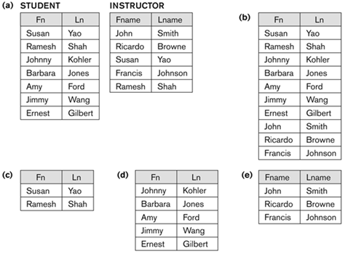
The Set Operations
b. STUDENT ∪ INSTRUCTOR
c. STUDENT INSTRUCTOR
d. STUDENT - INSTRUCTOR
e. INSTRUCTOR - STUDENT
∪
Chapter 7: The Relational Algebra and Relational Calculus
19

Slide 21
Relational Algebra Operations From Set Theory
CARTESIAN PRODUCT
This operation is used to combine tuples from two relations in a
combinational fashion.
The result denoted by R1 x R2 is a relation that includes all the
possible combinations of tuples from R1 and R2.
It is not a very useful operation by itself but it is used in conjunction
with other operations.
Chapter 7: The Relational Algebra and Relational Calculus
20

Slide 22
Relational Algebra Operations From Set Theory
CARTESIAN PRODUCT
Example: retrieve a list of names of each female employee’s
dependents.
FEMALE_EMPS σ _{Sex=‘F’} (EMPLOYEE)
EMPNAMES π _{Fname, Lname, Ssn} (FEMALE _EMPS)
EMP_DEPENDENTS EMPNAMES x DEPENDENT
ACTUAL_DEPENDENTS σ _{Ssn=Essn} (EMP_DEPENDENTS)
RESULT π _{Fname, Lname, Dependent_name} (ACTUAL_DEPENDENTS)
Chapter 7: The Relational Algebra and Relational Calculus
21

Slide 23
Example
Chapter 7: The Relational Algebra and Relational Calculus
3

Slide 24
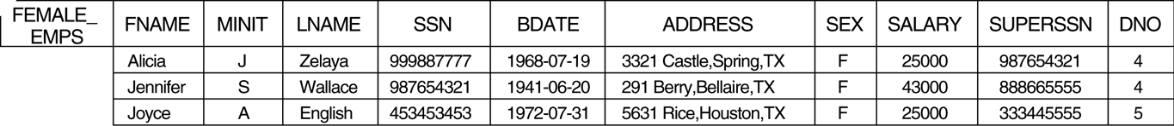
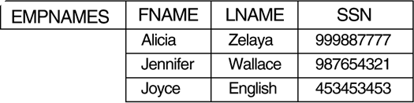
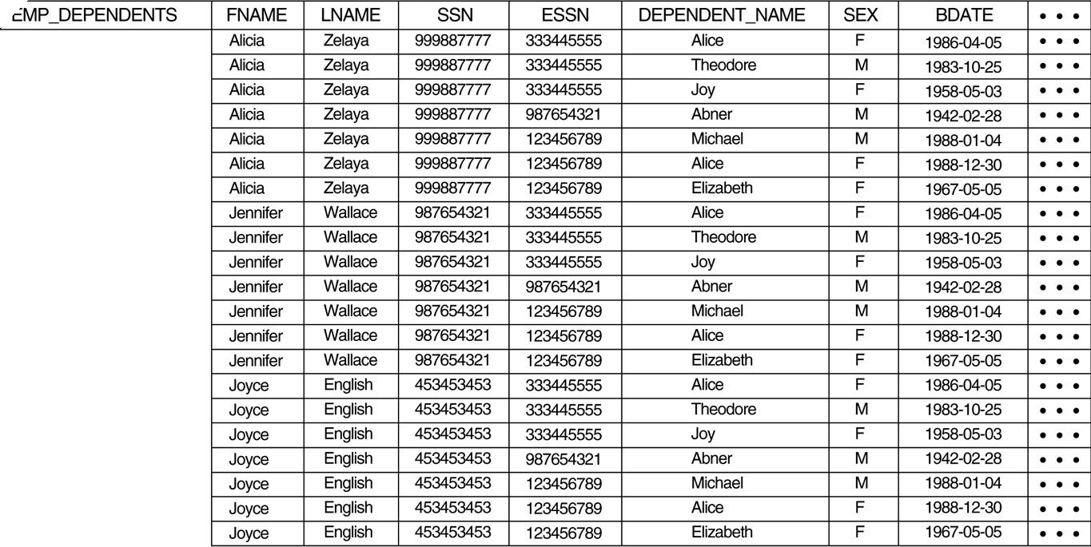

Relational Algebra Operations From Set Theory
CARTESIAN PRODUCT
Chapter 7: The Relational Algebra and Relational Calculus
22

Slide 25
Completeness of Relational Algebra
SELECT, PROJECT, UNION, MINUS, and CARTESIAN
PRODUCT are the basic operators of the relational algebra.
Additional operators are defined as combination of two or more of
the basic operations.
Example:
  JOIN = CARTESIAN PRODUCT + SELECT.
  DIVISION = PROJECT + CARTESIAN PRODUCT + MINUS.
Chapter 7: The Relational Algebra and Relational Calculus
23

Slide 26
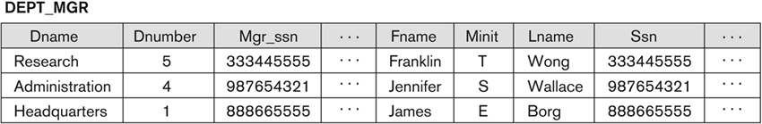
Binary Relational Operations - JOIN
The JOIN operation is used to combine related tuples from two
relations into single tuples.
Syntax: R _{<join condition>} S (does not require union compatibility of R and S).
Example: retrieve the name of the manager of each department.
DEPT_MGR DEPARTMENT _{Mgr_ssn=Ssn} EMPLOYEE
RESULT π _{Dname, Lname, Fname} (DEPT_MGR)
Chapter 7: The Relational Algebra and Relational Calculus
24

Slide 27
Binary Relational Operations - EQUIJOIN
Joins conditions with equality comparisons only.
In the result of an EQUIJOIN, one or more pairs of attributes always
have identical values in every tuple.
Chapter 7: The Relational Algebra and Relational Calculus
25

Slide 28
Binary Relational Operations - NATURAL JOIN
Because one of each pair of attributes with identical values is
superfluous, a new operation called NATUARAL JOIN was created
to get rid of the second (superfluous) attribute in an EQUIJOIN
condition.
The standard definition requires that the two join attributes, or each
pair of corresponding join attributes, have the same name in both
relations.
Syntax: R * S
Chapter 7: The Relational Algebra and Relational Calculus
26

Slide 29
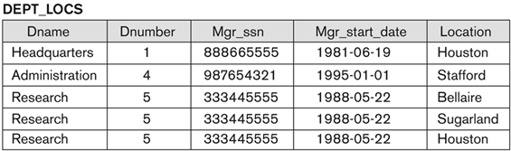
Binary Relational Operations - NATURAL JOIN
To apply a NATURAL JOIN on the DNUMBER attribute of
DEPARTMENT and DEPT_LOCATIONS, it is sufficient to write:
DEPT_LOCS DEPARTMENT * DEPT_LOCATIONS
Chapter 7: The Relational Algebra and Relational Calculus
27

Slide 30
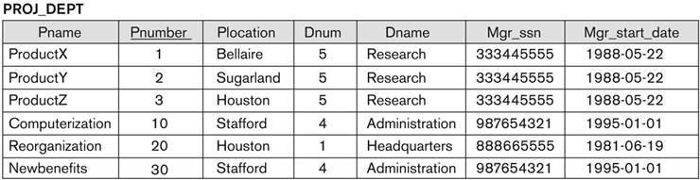
Binary Relational Operations - NATURAL JOIN
To apply a NATURAL JOIN on the department number attribute of
DEPARTMENT and PROJECT:
DEPT ρ (Dname,Dnum,Mgr_ssn,Mgr_start_date) (DEPARTMENT)
PROJ_DEPT PROJECT * DEPT
Chapter 7: The Relational Algebra and Relational Calculus
28

Slide 31
Binary Relational Operations - DIVISION
The division operation is applied to two relations R(Z) S(X),
where X is a subset from Z.
Example: retrieve the names of employees who work on all the
projects that ‘John Smith’ works on.
SMITH σ _{Fname=‘John’ AND Lname=‘Smith’} (EMPLOYEE)
SMITH_PNOS π _{Pno} (WORKS_ON _{Essn=Ssn} SMITH)
SSN_PNOS π _{Essn, Pno} (WORKS_ON)
SSNS(Ssn) SSN_PNOS SMITH_PNOS
RESULT π _{Fname, Lname} (SSNS * EMPLOYEE)
.
.
.
.
Chapter 7: The Relational Algebra and Relational Calculus
29

Slide 32
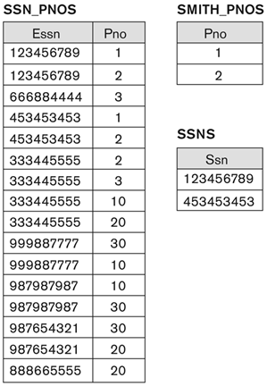
Binary Relational Operations - DIVISION
Chapter 7: The Relational Algebra and Relational Calculus
30

Slide 33
Additional Relational Operations
Aggregate Functions and Grouping
The first type of request that cannot be expressed in the basic
relational algebra is to specify mathematical aggregate functions on
collection of values from the database.
Common functions applied to collections of numeric values include:
  SUM.
  AVERAGE.
  MAXIMUM.
  MINIMUM.
The COUNT function is used for counting tuples or values.
Chapter 7: The Relational Algebra and Relational Calculus
31

Slide 34

Additional Relational Operations
Aggregate Functions and Grouping
Another common type of request involves grouping the tuples in a
relation by the value of some of their attributes and then applying an
aggregate function independently to each group.
Syntax: _{<grouping attributes>} _{<function list>} (R)
Example: COUNT _{Ssn} , AVERAGE _{Salary} (EMPLOYEE)
Chapter 7: The Relational Algebra and Relational Calculus
32

Slide 35
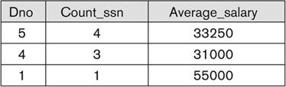
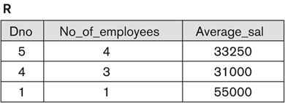
Additional Relational Operations
Aggregate Functions and Grouping
Example: Dno COUNT _{Ssn} , AVERAGE _{Salary} (EMPLOYEE)
Example: ρ R (Dno, No_of_employees, Average_sal) (Dno COUNT _{Ssn} , AVERAGE _{Salary} (EMPLOYEE))
Chapter 7: The Relational Algebra and Relational Calculus
33

Slide 36
Additional Relational Operations
OUTER JOIN Operations
In NATUARAL JOIN, the following tuples are eliminated from the
join result:
  Tuples without a matching (or related) tuple.
  Tuples with null in the join attributes.
A set of operations, called OUTER JOINs, can be used when we
want to keep all the tuples:
  in R, or
  in S, or
  in both relations
in the result of the join.
Chapter 7: The Relational Algebra and Relational Calculus
35

Slide 37
Additional Relational Operations
OUTER JOIN Operations
The left outer join operation ( R S) keeps every tuple in R, if no
matching tuple is found in S, then the attributes of S in the join
result are filled with null values.
The right outer join operation ( R S) keeps every tuple in S, if no
matching tuple is found in R, then the attributes of R in the join
result are filled with null values.
The full outer join operation (R S) keeps all tuples in both the left
and the right relations when no matching tuples are found, padding
them with null values as needed.
Chapter 7: The Relational Algebra and Relational Calculus
36

Slide 38
Additional Relational Operations
OUTER UNION Operation
The outer union operation was developed to take the union of tuples
from two relations if the relations are not union compatible.
Chapter 7: The Relational Algebra and Relational Calculus
37

Slide 39
Examples of Queries in Relational Algebra
Query 1: Retrieve the name and address of all employees who work
for the ‘Research’ department.
R_DEPT σ _{Dname=‘Research’} (DEPARTMENT)
R_EMPS (R_DEPT _{Dnumber=Dno} EMPLOYEE)
RESULT π _{Lname, Fname, Address} (R_EMPS)
Chapter 7: The Relational Algebra and Relational Calculus
38

Slide 40
Examples of Queries in Relational Algebra
Query 2: For every project located in ‘Stafford’, list the project
number, the controlling department, and the department manager’s
last name, address, and birth date.
S_PROJS σ _{Plocation=‘Stafford’} (PROJECT)
C_DEPT (S_PROJS _{Dnum=Dnumber} DEPARTMENT)
P_DEPT_MGR (C_DEPT _{Mgr_ssn=Ssn} EMPLOYEE)
RESULT π Pnumber, Dnum, Lname, Address, Bdate (P_DEPT_MGR)
Chapter 7: The Relational Algebra and Relational Calculus
39

Slide 41
Examples of Queries in Relational Algebra
Query 3: Find the names of employees who work on all projects
controlled by the department number 5.
D_5_PROJS(Pno) π _{Pnumber} (σ _{Dnum=5} (PROJECT))
EMP_PROJ(Ssn, Pno) π _{Essn, Pno} (WORKS_ON)
RESULT_EMP_SSNS EMP_PROJ D_5_PROJS
RESULT π _{Lname, Fname} (RESULT_EMP_SSNS * EMPLOYEE)
.
.
Chapter 7: The Relational Algebra and Relational Calculus
40

Slide 42
Examples of Queries in Relational Algebra
Query 4: Make a list of project numbers for projects that involve an
employee whose last name is ‘Smith’, either as a worker or as a
manager of the department that controls the project.
SMITHS(Essn) π _{Ssn} (σ _{Lname=‘Smith’} (EMPLOYEE))
SMITH_W_PROJ π _{Pno} (WORKS_ON * SMITHS)
MGRS π _{Lname, Dnumber} (EMPLOYEE _{Ssn=Mgr_ssn} DEPARTMENT)
SMITH_M_DEPTS(Dnum) π _{Dnumber} (σ _{Lname=‘Smith’} (MGRS))
SMITH_M_PROJS(Pno) π _{Pnumber} (SMITH_M_DEPTS * PROJECT)
RESULT (SMITH_W_PROJS ∪ SMITH_M_PROJS)
Chapter 7: The Relational Algebra and Relational Calculus
41

Slide 43
Examples of Queries in Relational Algebra
Query 5: list the names of all employees with two or more
dependents.
T1(Ssn, No_of_depts) Essn COUNT _{Dependent_name} (DEPENDENT)
T2 σ _{No_of_depts>1} (T1)
RESULT π _{Lname, Fname} (T2 * EMPLOYEE)
Chapter 7: The Relational Algebra and Relational Calculus
42

Slide 44
Examples of Queries in Relational Algebra
Query 6: Retrieve the names of employees who have no dependents.
ALL_EMPS π _{Ssn} (EMPLOYEE)
EMPS_WITH_DEPS(Ssn) π _{Essn} (DEPENDENT)
EMPS_WITHOUT_DEPS (ALL_EMP - EMP_WITH_DEPS)
RESULT π _{Lname, Fname} (EMPS_WITHOUT_DEPS * EMPLOYEE)
Chapter 7: The Relational Algebra and Relational Calculus
43

Slide 45
Examples of Queries in Relational Algebra
Query 7: list the names of managers who have at least one
dependent.
MGRS(Ssn) π _{Mgr_ssn} (DEPARTMENT)
EMPS_WITH_DEPS(Ssn) π _{Essn} (DEPENDENT)
MGRS_WITH_DEPS (MGRS EMPS_WITH_DEPS)
RESULT π _{Lname, Fname} (MGRS_WITH_DEPS * EMPLOYEE)
∪
Chapter 7: The Relational Algebra and Relational Calculus
44

Slide 46
The Relational Calculus
A relational calculus expression creates a new relation, which is
specified in terms of variables that range:
  Over rows of stored database relations (in tuple calculus), or
  Over columns of the stored relations (in domain calculus).
In a calculus expression, there is no order of operations to specify
how to retrieve the query result.
A calculus expression specifies only what information the result
should contain.
Chapter 7: The Relational Algebra and Relational Calculus
45

Slide 47
Introduction to Tuple Relational Calculus
Is based on specifying a number of tuple variables, each tuple
variable usually ranges over a particular database relation.
A simple tuple relational calculus query is of the form:
{t | COND(t)}
Example: find all employees whose salary is above $50,000.
{t | EMPLOYEE(t) AND t.Salary>50000}
Example: find the first and last names of all employees whose salary
is above $50,000.
{t.Lname, t.Fname | EMPLOYEE(t) AND t.Salary>50000}
Chapter 7: The Relational Algebra and Relational Calculus
46

Slide 48
The Existential and Universal Quantifiers
Two special symbols called quantifiers can appear in formulas:
  Existential quantifier (∃).
  Universal quantifier (∀).
Informally, a tuple variable t is bound if it is quantified, meaning
that it appears in an (∃ t) or (∀t) clause; otherwise, it is free.
Chapter 7: The Relational Algebra and Relational Calculus
47

Slide 49
Example Queries Using Existential Quantifier
Query 1: retrieve the name and address of all employees who work
for the ‘Research’ department.
Query 2: for every project located in ‘Stafford’, list the project
number, the controlling department number, and the department
manager’s last name, birth date, and address.
Q1: {t.Lname, t.Fname, t.Address | EMPLOYEE(t)
AND (∃d) (DEPARTMENT(d) AND d.Dname=‘Research’
AND d.Dnumber=t.Dno)}
Q2: {p.Pnumber, p.Dnum, m.Lname, m.Bdate, m.Address|
PROJECT(p) AND EMPLOYEE(m) AND
p.Plocation=‘Stafford’ AND ((∃d)(DEPARTMENT(d) AND
p.Dnum=d.Dnumber AND d.Mgr_ssn=m.Ssn))}
Chapter 7: The Relational Algebra and Relational Calculus
48

Slide 50
Introduction to Domain Relational Calculus
Example: Retrieve the name and address of all employees who work
for the ‘Research’ department.
{qsv | (∃z) (∃l) (∃m) (EMPLOYEE(qrstuvwxyz) AND
DEPARTMENT(lmno) AND l=‘Research’ AND m=z)}
Example: for every project located in ‘Stafford’, list the project
number, the controlling department number, and the department
manager’s last name, birth date, and address.
{iksuv | (∃j) (∃m) (∃n) (∃t) (PROJECT(hijk) AND
EMPLOYEE(qrstuvwxyz) AND DEPARTMENT(lmno) AND k=m
AND n=t AND j=‘Stafford’)}
Chapter 7: The Relational Algebra and Relational Calculus
52

